Slide 1
ECE 2220 Final Design Project
Burke Libbey
John Ermitanio
Crystal Kotlar

Slide 2
Agenda
Background
Project Summary
Technical Problems and Solutions
Problems we Encountered
Team Meetings and Collaborative Style
Conclusion
Question Period

Slide 3
The Project
Monitor NDB transmission
Compare transmitted morse code with stored sequence
Raise error if sequences don’t match

Slide 4
Background

Slide 5
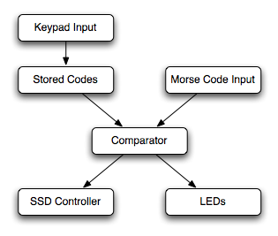
Technical Problems and Solutions

Slide 6
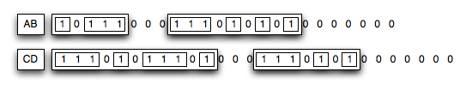
Technical Problems and Solutions
Morse Code

Slide 7
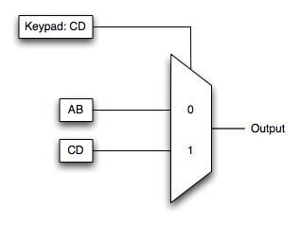
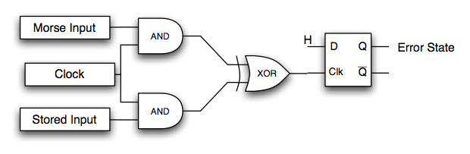
Technical Problems and Solutions
Multiple data streams

Slide 8
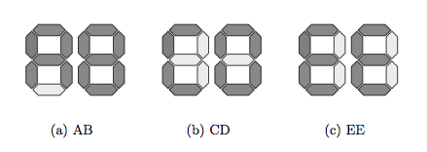
Technical Problems and Solutions
Output
‘AB’ or ‘CD’ when listening for a sequence or finished listening successfully.
‘EE’ when transmission failed
Three LEDs
  Red: Error
  Green: Success
  Yellow: Transmitting

Slide 9
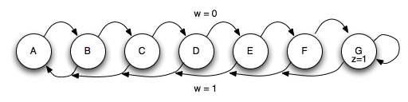
Technical Problems and Solutions
Finite State Machine

Slide 10
Technical Problems and Solutions
Division of Work
Burke
  Comparator
  Report
John
  Presentation
  Finite State Machine
Crystal
  Input/Output
  Testing/Debugging

Slide 11
Problems we encountered
Timing of shift registers
D Flip-flop hell
Combining sub-projects

Slide 12
Team Meetings and Collaborative Style

Slide 13
Conclusion

Slide 14
Questions?

